Slide 1

DEPARTMENT OF
ARTIFICIAL INTELLIGENCE AND DATA SCIENCE
ACADEMIC YEAR 2025 - 2026
SEMESTER III
ARTIFICIAL INTELLIGENCE LABORATORY
MINI PROJECT REVIEW
ROCK-PAPER-SCISSORS AI (RANDOM + LEARNING)
REGISTER NUMBER | 2117240070252
NAME | P.N.Rathish
YEAR | 2025 - 2026
SECTION | E
FACULTY IN-CHARGE | Ms. M. Bhavani

Slide 2
PROBLEM STATEMENT
Rock-Paper-Scissors appears simple, but human unpredictability makes it challenging for AI.
Standard versions use random moves, resulting in predictable and non-intelligent behavior. In reality, players often follow subconscious patterns that a learning-based AI can detect and exploit.
The task is to develop an AI that observes past player moves, identifies recurring patterns, and predicts the next action.
The system must balance randomness to stay unpredictable while learning to adapt its strategy.
The goal is to build a self-improving AI that offers a stronger challenge and demonstrates key principles of machine learning and pattern recognition.

Slide 3
THEORETICAL BACKGROUND
  The project is based on learning agents and pattern recognition.
  The AI learns from player behavior by storing recent move sequences and tracking which move usually follows them.
  Using this frequency-based pattern model, similar to a low-order Markov chain, the AI predicts the player’s next move and selects the counter.
  Advanced methods like reinforcement learning or neural networks are unnecessary here; the chosen approach is simple, fast, interpretable, and effectively demonstrates core AI concepts such as pattern detection and adaptive decision-making.

Slide 4
IMPLEMENTATION AND CODE
Link to code in Git-hub Repository
List | Git-hub Repository Links
Implementation of Code Link | https://github.com/Rathish-1112/rock-paper-scissors-Ai-mini-project/commit/cff053f15097990b84a6d5608de2f09917fbfd83
Word Document Report Link | https://github.com/Rathish-1112/rock-paper-scissors-Ai-mini-project/commit/d9272a86e07235df33bdcef5b12ef4fa6fa20e55
PPT Link

Slide 5
OUTPUT AND RESULTS
When the program runs, a GUI opens with buttons for Rock, Paper, and Scissors. Each round shows the player’s move, the AI’s move, and the result.
The interface updates statistics in real time, including AI wins, player wins, ties, and win rate.
As more rounds are played, the AI gradually learns recurring patterns in the player’s moves and improves its win rate.

Slide 6
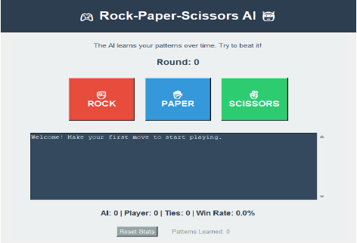
OUTPUT AND RESULTS

Slide 7
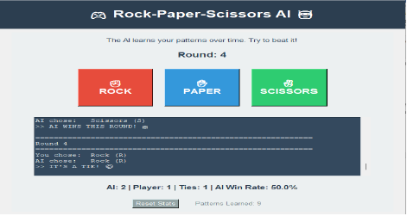
OUTPUT AND RESULTS

Slide 8
OUTPUT AND RESULTS
The Rock-Paper-Scissors AI was successfully built and showed clear adaptive learning behavior. As the AI gathered more player data, it identified repeating patterns and increased its win rate, demonstrating that simple frequency-based models can still produce intelligent game responses.
Future enhancements include:
Adding reinforcement learning for reward-based improvement
Introducing multiple difficulty levels
Including visual analytics to show learning progress
Developing a web version for multi-user gameplay
Expanding the game with additional moves such as the Lizard-Spock variant

Slide 9
REFERENCES
1. Russell, S., & Norvig, P. (2021). Artificial Intelligence: A Modern Approach (4th Edition). Pearson.
2. GeeksforGeeks – Rock Paper Scissors Python Implementation.
3. RealPython – Building Tkinter GUIs in Python.
4. Analytics Vidhya – Pattern Recognition and Machine Learning Simplified.
5. Medium Blog – Designing AI Opponents in Games Using Simple Heuristics

